Slide 1

SPOTIFY CLUSTERING ANALYSIS BASED ON POPULARITY FROM INDONESIAN MUSIC CHART
GROUP E - TEAM 2 - SHANGHAI - JAN232023
REVOU GROUP FINAL PROJECT

Slide 2
GROUP FINAL PROJECT
GROUP E -SHANGHAI
JAN23

Slide 3





PIC
Rai Fathurachman
Project Manager
Aminuddin
Data Cleaning & Analysis team
Fikri Firstly
Visualization & Presentation Team
Nhanhe
Visualization & Presentation Team

Slide 4
TABLE OF CONTENT
Project Overview
Objective & Scope
Research Questions & Methodology
Main Objective
Scope Definition
Research Questions
Methodology
Data Source
Data Analysis
Insights & Recommendations
Data Source
Information about each data source
Data Analysis
Data Visualization
Dashboards
Insights from research
Recommendation

Slide 5
PROJECT OVERVIEW
€3.1
Million
21%
Shares comes from USA + Canada
We wanted to analyze the music data to find what’s the phenomenon behind it. Why some artist, genre are so popular among others !
Total Revenue
489 Million
205 Million
Monthly Active User
Premium Active User

Slide 6
WHAT MUSIC TASTE DOES INDONESIAN STREAMERS LIKE THREE YEARS PRIOR TO 2017 TO 2020?

Slide 7
METHODOLOGY
DATA GATERING
DATA CLEANING
DATA ANALYSIS
INSIGHT AND RECOMMENDATION
Data gathering about the spotify trend music
EDA using Python to find patterns and insight
Provide recommendation from data analysis
Change datatype, remove null, and irrelevant values, using python

Slide 8
DATASET OVERVIEW
Data
Spotify HUGE database - daily charts over 3 years | Kaggle
2017 - 2020 DATABASE
8 MILLIONS ROWS

Slide 9
Kaggle
dataset contains all the songs in Spotify's Daily Top 200 charts in 35+1 (global) countries around the world for a period of over 3 years (2017-2020).
2 Tables
Database to Calculate Popularity + Final Database
Database to Calculate Popularity
Final Database
Join Tables Using Python
Includes all the daily entries (8mln+) for the songs which made it to the top 200
includes many data for each song. It aggregates the popularity for songs into a single score for each.
2 Tables Join using Inner Join based on URI of each unique song.

Slide 10
DATA CLEANING PROCESS
Python
Spreadsheet
Visualization
The data we gathered then being processes using python since the data is too big.
Then we reduce the scoop of music data to only Indonesian listeners
Anything else, most of the data provided are clean!
Although we’ve been checked the data types, sometimes we need just to make sure the real data.
Since the data shrank to only under 7 thousand row, we used spreadsheet to clean data if necessary
Tableu Public Desktop are used to change the data types if necessary.
Simple calculation for specific needed are used in Tableu Public

Slide 11
EDA
Exploratory Data Analysis

Slide 12
3069
TOTAL SONG
1402
TOTAL UNIQUE ARTIST
2056
TOTAL UNIQUE ALBUMS
Ed Sheeran
MOST POPULAR ARTIST IN INDONESIA

Slide 13
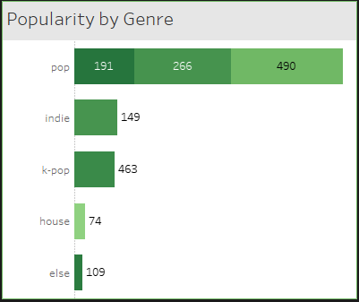
Top number 1 genre in Indonesia is Pop and it’s from foreign country.
The number 2 genre is Indie which comes mostly from Indonesian song. A normal thing that happens in every country.

Slide 14

5 MAIN POINT MUSIC CHARACTERISTICS TO ANALYZE
Energy
Valence
Acousticness
Speechness
liveness
*based on Spotify algorithm music detection

Slide 15
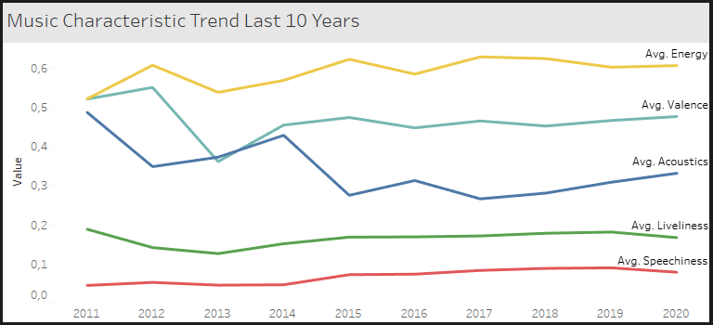
LET US SEE HOW’S THE MUSIC CHANGES LAST 10 YEARS BASED ON POPULARITY TRENDS

Slide 16
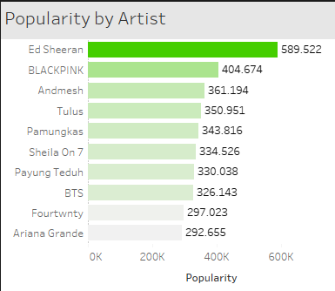
TOP 10 MOST POPULAR ARTIST IN INDONESIA

Slide 17
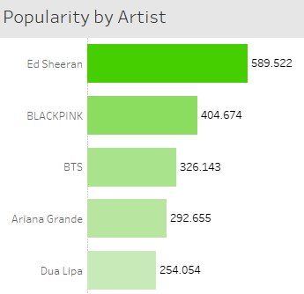
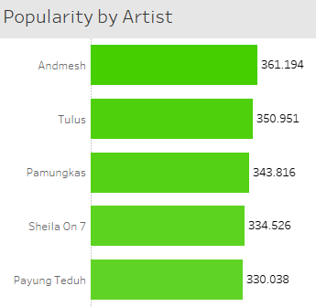
FOREIGN ARTIST VS INDONESIAN ARTIST
*FILTERED INDONESIAN ARTIST ONLY

Slide 18
# 1 CHART Vs # 101 CHART
Lets Compare the Chart shall we?
COMPARING TWO ARTIST

Slide 19
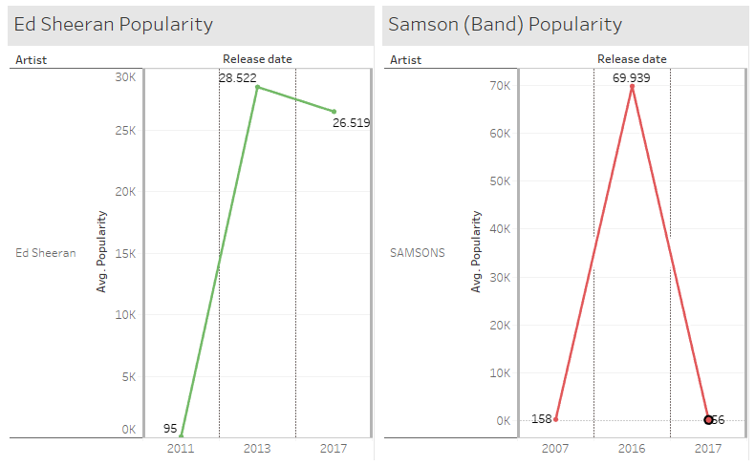
Number 1 Popular Vs Number 101 in Indonesian Chart
In 2011 Ed Sheeran released an song and the popularity score is above 28 Thousand and in 2017 stay relatively still
BUT!
In some case Samson’s song in 2016 is more popular than Ed Sheeran song with almost 70 Thousand score but then decreasing to only 56 making it not so popular anymore

Slide 20
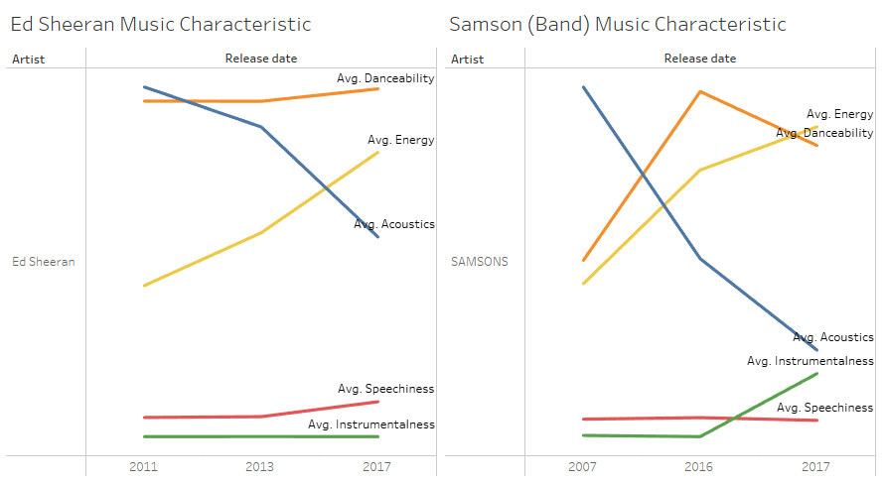
How’s The Music Characteristic between the two?
- Most Ed sheeran popular have high acousticness song and high danceablity. But not so energetic
-Samson’s song in other hand Avg. Danceabilty are higher and acousticness level are low.
IT SHOWS THESE 2 MUSIC TYPE ARE DIFFERENT FROM EACH OTHER

Slide 21
FURTHER ANALYSIS

Slide 22
DOES MUSIC CHARACTERISTIC AFFECT THE POPULARITY?

Slide 23
CLUSTERING ANALYSIS
Cluster 1 | Cluster 2 | Cluster 3
Popularity
Low Popularity, Moderate Followers | High Popularity, Highest Followers | Highest Popularity, High Followers
Music Attributes
High value on danceability, energy, loudness, speechiness, liveliness, valence & tempo | Moderate value on danceability, energy, loudness, speechiness, liveliness, valence & tempo. Also on Acousticness & Instrumentalness | Low value on danceability, energy, loudness, speechiness, liveliness, valence & tempo, Highest on Acousticness & Instrumentalness

Slide 24
Ini buatan mas didin untuk table clustering yg diatass
Cluster 0 memiliki Popularity yang paling rendah, namun Artist_followers cukup besar dibandingkan cluster 2. Rata-rata nilai dari fitur musik seperti danceability, energy, loudness, speechiness, liveliness, valence dan tempo adalah yang tertinggi dibandingkan cluster lainnya. Accoustics dan instrumentalness adalah yang terendah. Dapat disimpulkan bahwa Cluster 0 cenderung menghasilkan lagu-lagu dengan beat yang danceable dan energik, serta memiliki nuansa yang positif dan ceria. Lagu-lagu pada cluster ini mungkin lebih cocok untuk genre pop, dance-pop, atau electro-pop. Contohnya adalah lagu-lagu dari Justin Bieber, Dua Lipa, dan The Weeknd.
Cluster 1 memiliki Popularity yang cukup tinggi, namun Artist_followers adalah yang terbesar. Rata-rata nilai dari fitur musik seperti danceability, energy, loudness, speechiness, liveliness, valence dan tempo adalah yang moderat dibandingkan cluster lainnya. Namun, nilai accoustics-nya lebih tinggi dibandingkan cluster 0. kluster ini memiliki popularitas yang cukup tinggi, dan cenderung menghasilkan lagu-lagu dengan nuansa akustik dan instrumen yang minim, namun masih tergolong danceable dan memiliki nuansa yang positif. Contoh genre musik yang bisa disarankan adalah indie pop atau acoustic pop, dan beberapa contoh artis yang bisa direkomendasikan adalah Ed Sheeran.
Cluster 2 memiliki Popularity yang paling tinggi dan Artist_followers juga yang terbesar. Rata-rata nilai dari fitur musik seperti danceability, energy, loudness, speechiness, liveliness, valence dan tempo adalah yang terendah dibandingkan cluster lainnya. Namun, accoustics dan instrumentalness adalah yang tertinggi. Contoh genre yang dapat direkomendasikan untuk genre pada cluster 2 adalah musik ballad, pop ballad, atau acoustic. Contoh artisnya adalah Adele, Sam Smith, atau Billie Eilish.

Slide 25
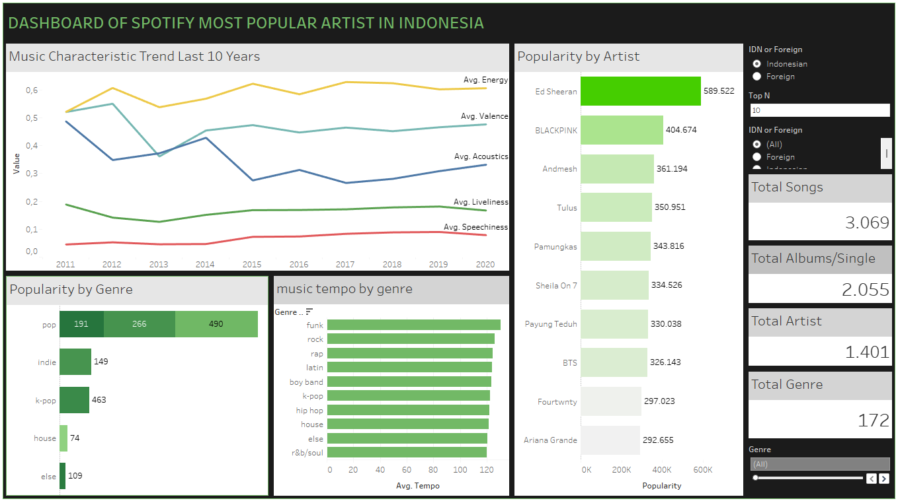
THE TABLEAU DASHBOARD
Link to Dashboard

Slide 26
INSIGHT

Slide 27
RECOMMENDATION
APAYAA
APAAN YAAA
MIKIR DULUUUU
SILAHKAN BERFIKIRRR

Slide 28
THANK YOU!

Slide 29
LINK TO PROJECT
Google Collab
https://colab.research.google.com/drive/1YEBXj4OPSIFRmhYNDDVxPPMdijJb8yL5?usp=share_link
Tableu Public
https://public.tableau.com/app/profile/rai.muhammad/viz/TeamE_SpotifyDataset_RevoUPitchingDay_16807137623000/Dashboard1?publish=yes
FURTHER REFERENCE
Spotify Share Holder Deck 2022 Q4
Spotify - Investor Relations

